Slide 1
ANDI DWI SAPUTRO
Presentasi Tugas 1 Bootcamp Java Nusacamp

Slide 2
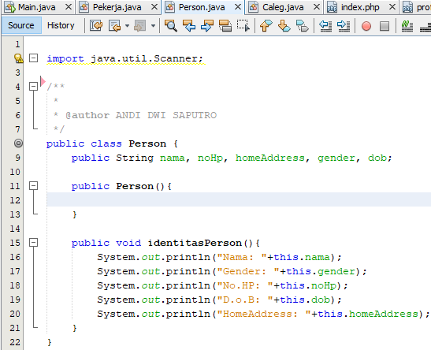
Class Person

Slide 3
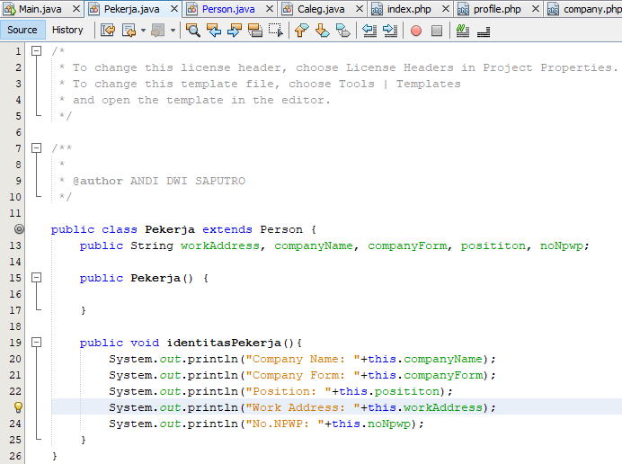
Class Pekerja

Slide 4
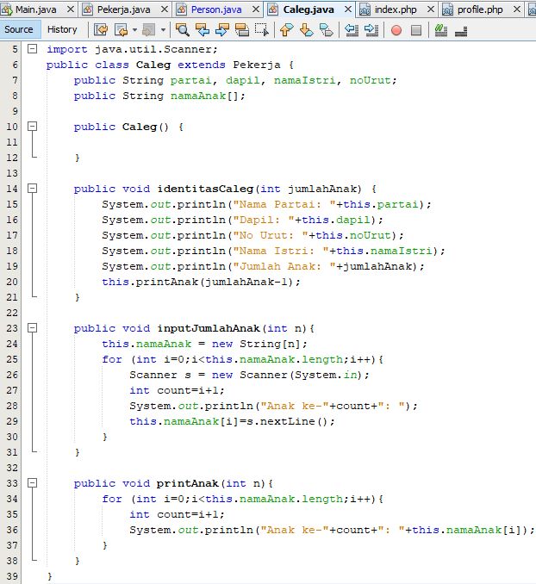
Class Caleg

Slide 5
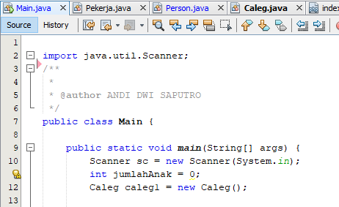
Main Class (part 1)

Slide 6
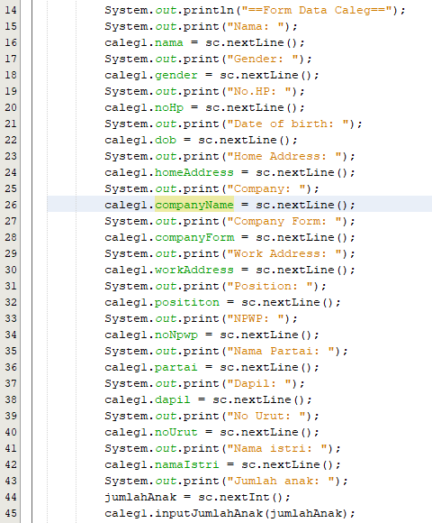
Main Class (Part 2)

Slide 7
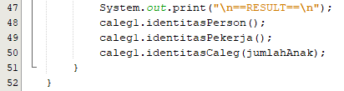
Main Class (Part 3)

Slide 8
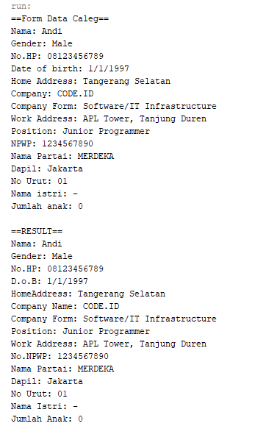
RESULT

